Slide 1

“Optimising Sales and Profitability: The AdventureWorks Case Study”
A

Slide 2
Project By :
Bhavana Bolineni
Abhishek Patil
shraddha munnoli
Priya singh
Swapnil nerkar
Ashwin pujari

Slide 3

Introduction
AdventureWorks Cycles Overview:
A multinational bicycle manufacturing company
Manufactures metal and composite bikes
HQ: Bothell, Washington; manufacturing plant in Mexico
Goal: Increase market share, reduce production costs, and target high-value customers.
Problem Statement:
To analyze their sales, production, and customer data to identify trends, profitable products, cost optimization opportunities, and strategic recommendations for business growth.

Slide 4
Key Performance Indicators (KPIs):
Insights Derived:
Highest sales in 2013
Mountain-200 Black bikes drive maximum revenue and profit
Sales are highest in United States and Australia
Bachelor's degree holders contribute maximum profit
Accessories underperform – consider bundling offers
Production costs decreased by 21.24% while sales rose – excellent cost management
Total Sales: ₹29.36M 💰
Total Profit: ₹12.08M 📈
Profit Margin: 41.15% 🏆
Total Customers: 18.48K 👥
Total Orders: 27,659 📝

Slide 5
Dashboards :

Slide 6
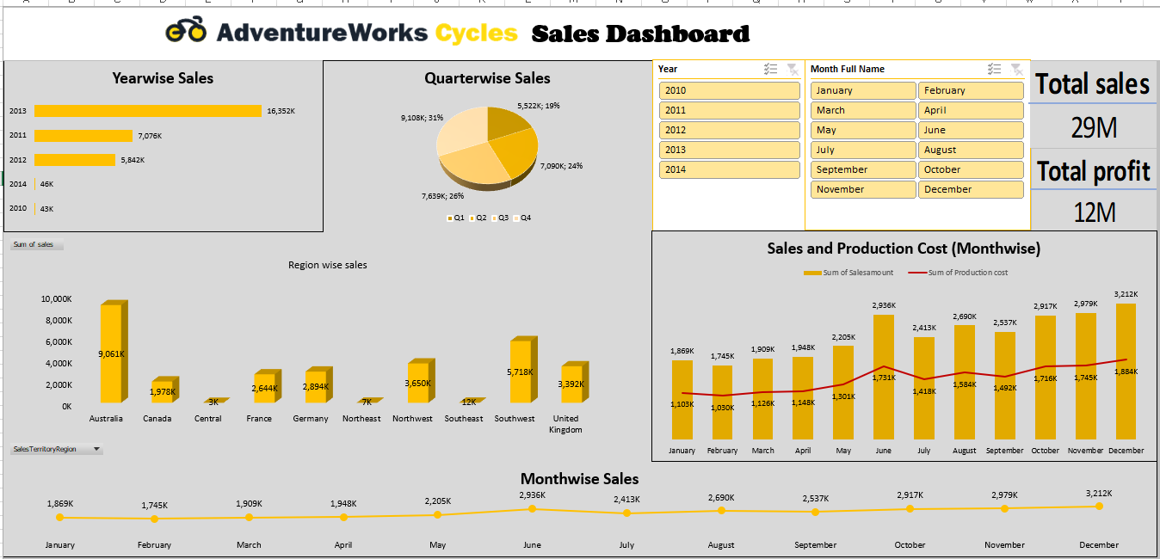
Excel:

Slide 7

✅ Highlights:
Yearwise sales with peak in 2013
Region-wise sales: Australia leads with 9M+
Quarterwise trends: Q4 highest sales
Monthwise comparison of sales vs production cost shows controlled costs with rising sales.

Slide 8
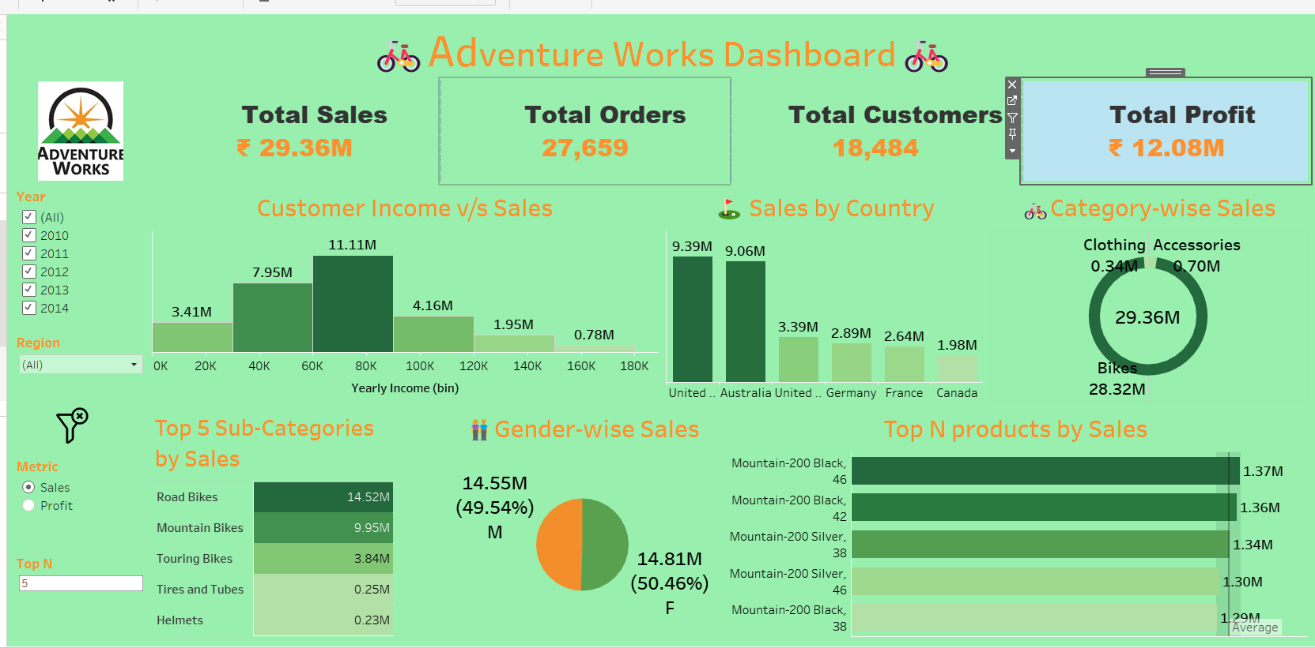
Tableau :

Slide 9
✅ Highlights:
Customer income vs sales: Max sales from 60K-80K income group
Sales by country: US and Australia dominate
Category-wise sales: Bikes at 28.32M, Accessories lowest
Gender-wise sales almost equal: M (49.54%) & F (50.46%)
Top sub-categories: Road Bikes (14.52M) and Mountain Bikes (9.95M)

Slide 10
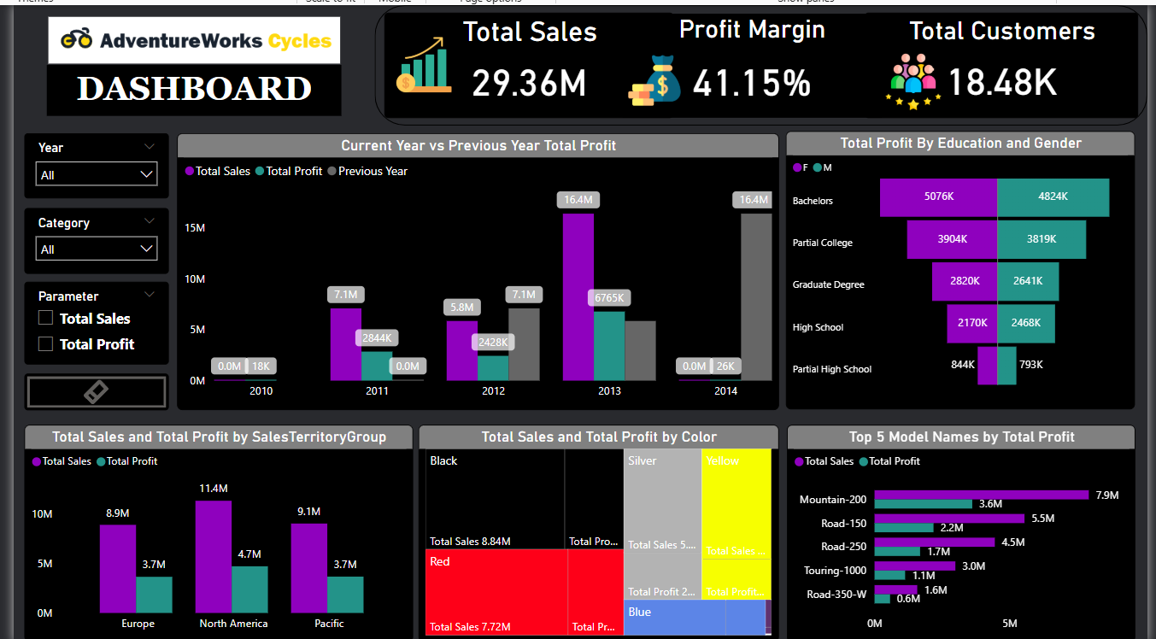
Power BI :

Slide 11
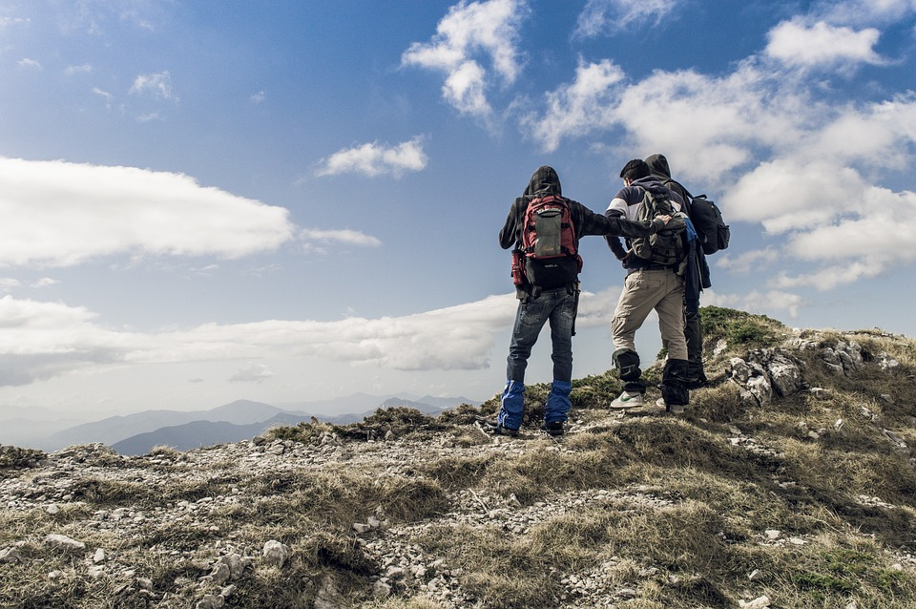
✅ Highlights:
Yearly total sales and profit comparison
Sales vs previous year performance consistently increasing
Total profit by education: Bachelors highest, partial high school lowest
Top 5 models by profit: Mountain-200 highest at 7.9M profit
Sales & profit distribution by region and color category

Slide 12
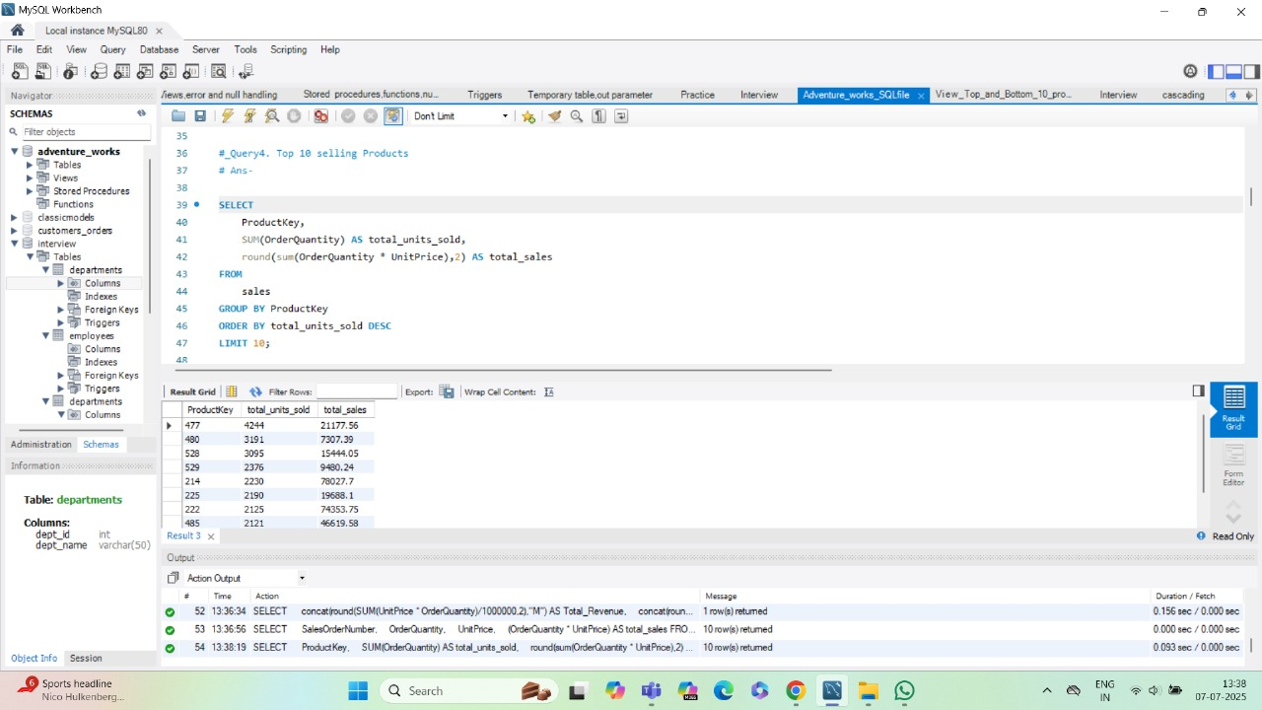
SQL Queries

Slide 13
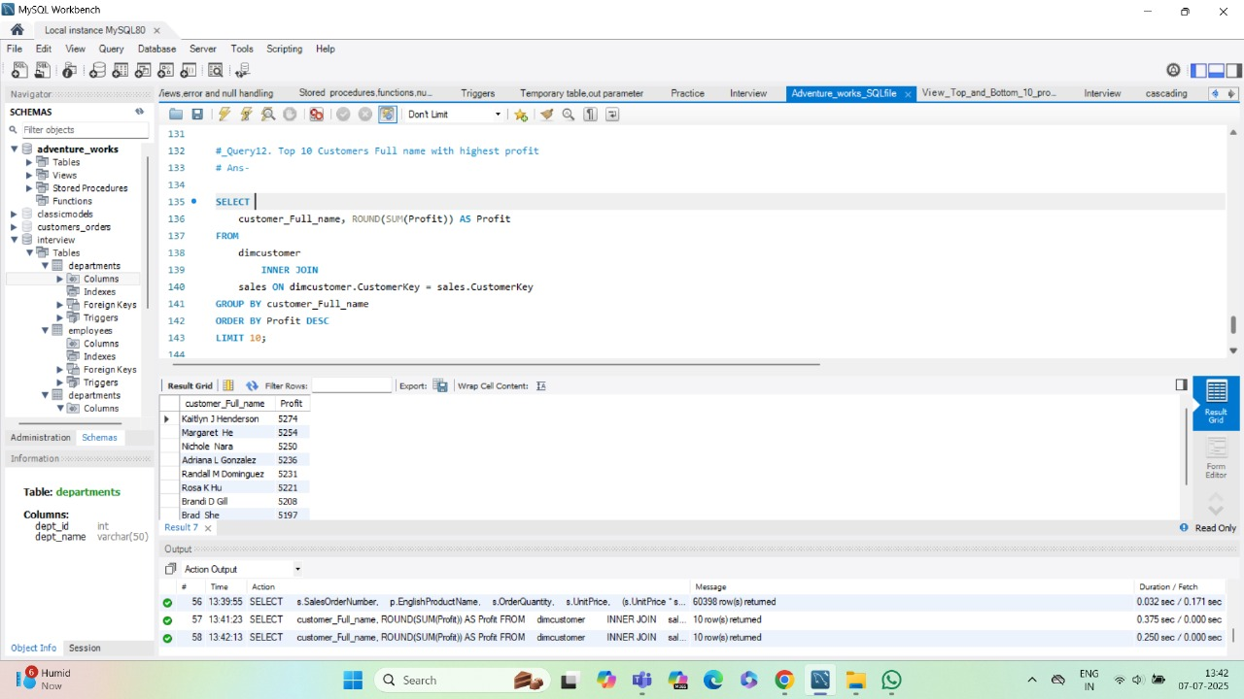

Slide 14
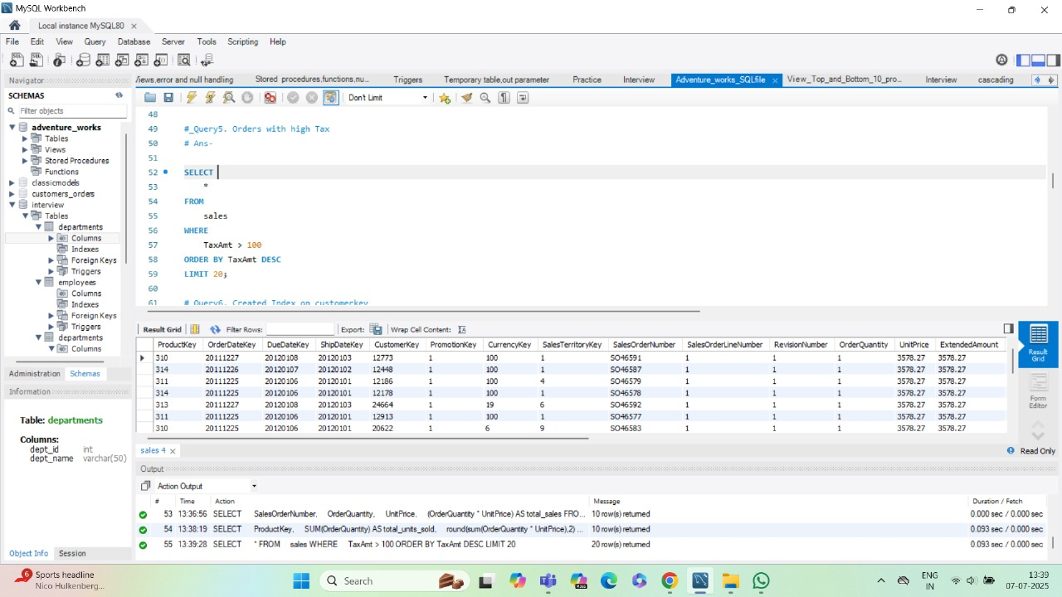

Slide 15
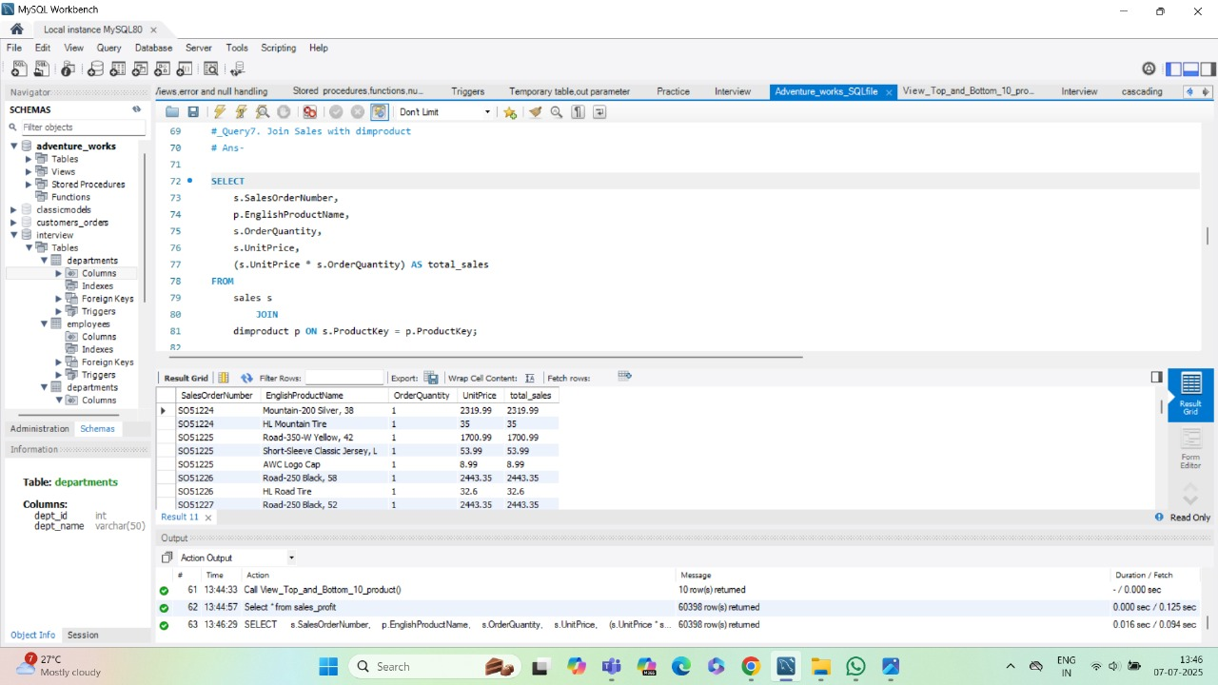

Slide 16
✅ Highlights:
Query 1: Join Sales with DimProduct
Purpose: Retrieve sales order number, product name, order quantity, unit price, and calculate total sales.
Insight: Helps analyse total sales revenue per product efficiently by joining sales and product tables.
Query 2: Orders with High Tax
Purpose: Select orders with tax amount > 100, ordered by highest tax.
Insight: Identifies high tax-paying transactions which impact total billing and can be useful for taxation analysis and compliance reviews.
Query 3: Top 10 Customers with Highest Profit
Purpose: Lists top customers by aggregated profit contribution, displaying customer full name and total profit.
Insight: Highlights most profitable customers for targeted retention, loyalty programs, and personalised marketing strategies.
Query 4: Top 10 Selling Products
Purpose: Retrieves products with the highest total units sold and calculates their total sales value.
Insight: Identifies best-selling products for inventory planning, production focus, and maximising sales strategies.

Slide 17
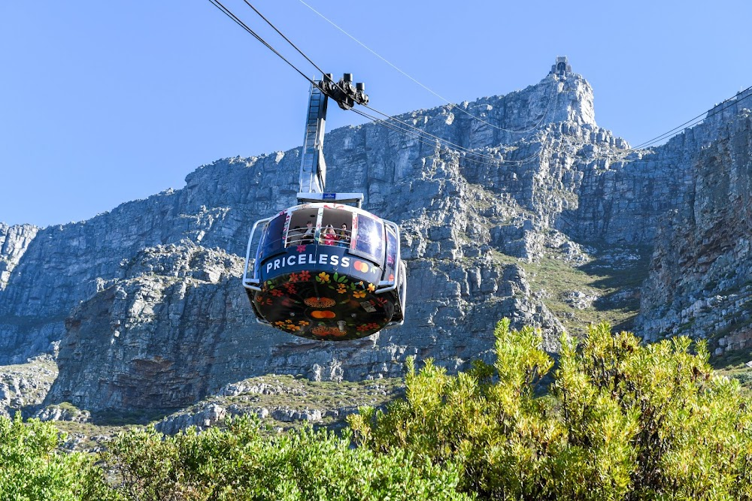
Key Learnings:
Importance of data cleaning before visualization
SQL query proficiency for data extraction
Dashboard design using Excel, Tableau, and Power BI
Business insights interpretation and presentation skills
Team coordination for effective project execution
Impact:
Enabled data-driven decisions for marketing focus, production optimization, and sales targeting
Recommended Asia expansion, better accessory promotion, and strategic model-specific focus.

Slide 18

Summary:
Focus marketing efforts on peak months (December, Q4)
Increase production of high-selling bikes (Mountain-200 Black)
Improve accessory sales through bundling and promotions
Consider a Pacific manufacturing unit to reduce logistics costs to Australia
Continue cost efficiency initiatives to maintain profit margins

Slide 19

Thank You

